Slide 1
Remote patient management after discharge of hospitalized heart failure patients: the Better Effectiveness After Transition - Heart Failure (BEAT-HF) study
Michael K Ong MD PhD^{1, 9}, Patrick S Romano MD MPH², Sarah Edgington MA¹, Harriet U Aronow PhD⁶, Andrew D Auerbach MD MPH⁵, Jeanne T Black PhD MBA⁶, Teresa De Marco MD⁵, Jose J Escarce MD PhD^{1, 7}, Lorraine Evangelista RN PhD³, Barbara Hanna RN PhD(c) ², Theodore G Ganiats MD^{4, 8}, Barry Greenberg MD⁴, Sheldon Greenfield MD MPH³, Sherrie H Kaplan PhD MPH³, Asher Kimchi MD⁶, Honghu Liu PhD¹, Dawn Lombardo MD³, Carol M Mangione MD MSPH¹, Bahman Sadeghi MD MBS¹, Banafsheh Sadeghi MD PhD², Majid Sarrafzadeh PhD¹, Kathleen Tong MD², Gregg C Fonarow MD¹, and the BEAT-HF Research Group
¹University of California, Los Angeles; ²University of California, Davis; ³University of California, Irvine; ⁴University of California, San Diego; ⁵University of California, San Francisco; ⁶Cedars-Sinai Medical Center; ⁷RAND Corporation; ⁸University of Miami; ⁹VA Greater Los Angeles Healthcare System
Supported by the Agency for Healthcare Research and Quality (R01 HS019311), the National Heart Lung and Blood Institute (RC2 HL101811), the National Center for Advancing Translational Science UCLA CTSI (UL1TR000124), the Robert Wood Johnson Foundation (66336), the Sierra Health Foundation, the University of California Center for Health Quality and Innovation, and the participating institutions.
Author potential conflicts of interests: Dr. De Marco: Consultant: Boston Scientific, Cardiokinetics, Gambro; Advisory Boards: Otsuka, Bayer. Dr. Fonarow: Consultant: Amgen, Bayer, Baxter, Medtronic, Novartis

Slide 2
Background
It remains unclear if telemonitoring approaches provide benefits for heart failure (HF) patients following hospitalization.
Systematic reviews of smaller studies show readmission and mortality reductions
Recent large RCTs (e.g., Tele-HF, TIM-HF) showed no benefit for readmission or mortality
Multiple potential explanations for recent RCTs lack of benefit
Adherence concerns: newer remote monitoring approaches and engaging patients prior to discharge could improve adherence
Telemonitoring approach: pairing remote monitoring with a telephone-based nurse care manager using scheduled contacts similar to in-person care transition programs could improve outcomes

Slide 3
Study Objective
Evaluate the effectiveness of a care transition intervention using remote patient monitoring among a broad population of older adults hospitalized with HF
Primary outcome: 180-day all-cause readmission
Secondary outcomes: 30-day all-cause readmission, 30-day mortality, and 180-day mortality

Slide 4
Study Methods: Intervention
Pre-discharge HF education
Low health literacy self-management using “teach-back” techniques
Use of telemonitoring equipment
Regularly scheduled telephone coaching
9 telephone health coaching calls by RN starting 2-3 days after discharge
Weekly calls for first month, monthly calls through 6 months
Telemonitoring: weight, blood pressure, heart rate, symptoms
Daily use of Bluetooth-enabled weight scale and a blood pressure/heart rate monitor integrated with text device
Data transferred via cellular bandwidth, daily review by RN
Patients called if exceeded predetermined threshold parameters
Patient’s HF providers notified for significant symptoms, if necessary sent to ED

Slide 5
Study Methods: Evaluation
Prospective RCT: intervention vs. usual care
Conducted at six academic health systems in California
Study population: Individuals age 50 or older hospitalized and receiving active treatment for decompensated HF
Defined as HF with initiation of or an increase in diuretic treatment
Exclusions: could not fully participate in intervention, expected intensive post-discharge care, HF expected to improve after procedure

Slide 6
Study Methods: Analyses
Intention to treat framework
80% power to detect a 28% relative reduction in primary outcome
Unadjusted and adjusted survival analyses and multivariable logistic regressions
Adjusted models controlled for age, gender, race/ethnicity, insurance, income, social isolation, comorbidities, year and quarter of enrollment, with enrollment site as random effects
Post-hoc analyses on adherence to intervention
Adherence evaluated based on total days alive
Additionally adjusted for education and baseline scores for self confidence and self maintenance in managing HF

Slide 7
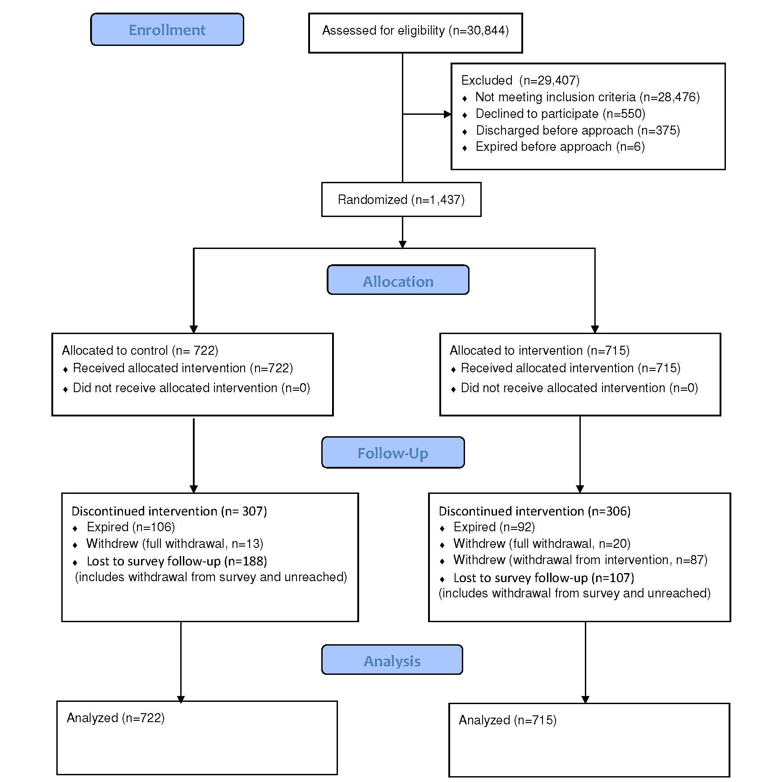

Slide 8
Results
 | Intervention (N = 715) |  | Usual Care (N = 722)
 | Mean | 95% CI | Mean | 95% CI
Median Age (IQR) | 73 | (62 - 84) | 74 | (63 - 82)
Demographics
Female | 45.40 | (41.57 - 49.23) | 45.70 | (41.90 - 49.50)
African American | 22.09 | (18.89 - 25.28) | 22.32 | (19.14 - 25.50)
Hispanic/Latino | 11.35 | (8.91 - 13.79) | 10.41 | (8.08 - 12.74)
Caucasian/White | 54.60 | (50.77 - 58.43) | 54.90 | (51.10 - 58.70)
Asian/Pacific Islander/Other | 11.96 | (9.47 - 14.46) | 12.37 | (9.86 - 14.88)
HF Severity
NYHA Class I | 0.17 | (-0.16 - 0.50) | 0.69 | (0.01 - 1.36)
NYHA Class II | 23.44 | (20.02 - 26.86) | 25.82 | (22.25 - 29.39)
NYHA Class III | 65.60 | (61.76 - 69.43) | 63.86 | (59.94 - 67.77)
NYHA Class IV | 10.79 | (8.29 - 13.30) | 9.64 | (7.23 - 12.05)

Slide 9
Results
1,437 individuals enrolled and randomized between October 2011 and September 2013
715 intervention, 722 usual care
No significant participant characteristics differences between groups
Median age 73 years; 45.6% were female, 22.2% were African American, 61.2% New York Heart Association (NYHA) III or IV
Intervention
82.7% of participants used the telemonitoring equipment
At 180 days, >50% calls: 68.0%, >50% telemonitoring 51.7%
221,211 remote observations, 18,531 exceeded threshold parameters
median of 22 (interquartile range, IQR, 8 to 48) per participant
3,700 scheduled health coaching calls completed
median of 6 (IQR, 3 to 8) per participant

Slide 10
Results
Hazard ratio for 30-day readmission with intervention 1.03 (95%CI 0.83 – 1.29)
Adjusted hazard ratio for 30-day readmission with intervention 1.01 (95%CI 0.80 – 1.28)
Hazard ratio for 180-day readmission with intervention 1.03 (95%CI 0.89 – 1.19)
Adjusted hazard ratio for 180-day readmission with intervention 1.03 (95%CI 0.88 – 1.20)

Slide 11
Results
Hazard ratio for 30-day mortality with intervention 0.61 (95%CI 0.37 – 1.02)
Adjusted hazard ratio for 30-day mortality with intervention 0.53 (95%CI 0.31 – 0.93)
Hazard ratio for 180-day mortality with intervention 0.88 (95%CI 0.67 – 1.15)
Adjusted hazard ratio for 180-day mortality with intervention 0.85 (95%CI 0.64 – 1.13)

Slide 12
Results
 |  | Proportion of calls completed |  |  |  | Proportion of days monitored
 | Overall |  | <50% | >50% |  |  | <50% | >50%
Readmit
30 day | 23.3 |  | 34.7 | 14.9*** |  |  | 34.6 | 13.0***
180 day | 52.2 |  | 54.0 | 49.6 |  |  | 61.1 | 41.3***
Mortality
30 day | 3.4 |  | 8.7 | 0.6*** |  |  | 6.6 | 0.7***
180 day | 14.0 |  | 26.0 | 8.3*** |  |  | 21.4 | 6.6***
***p<0.001

Slide 13
Limitations
Study sites are all California academic medical centers
3/6 sites were safety net hospitals, broad patient eligibility criteria increases generalizability.
Use of other types of personnel instead of registered nurses potentially could have affected study outcomes.
Intervention not directly integrated with the physician practices caring for the patients
Increasingly possible with advances in electronic health records.
Rapid technological change with remote patient monitoring
Newer approaches, such as implantable devices or tablets and unobtrusive sensors could increase adherence or provide better information to identify problems following discharge.

Slide 14
Conclusions
The BEAT-HF study found that a combination of remote patient monitoring with care transition management did not reduce 180 day all cause readmission after HF hospitalization
Hospitalizations in the first 30 days and 180 day mortality were also not reduced with the intervention
Mortality in the first 30 days was reduced significantly in prespecified multivariable adjusted analyses
Case review indicates due to in-hospital death differences after randomization, less likely to be due to the intervention

Slide 15
Conclusions
Individuals with higher adherence may experience fewer readmissions and deaths than those with lower levels of adherence
further studies specifically designed to evaluate effects of different levels of adherence are needed to confirm these findings as these were from post-hoc analyses
BEAT-HF designed to determine the effectiveness of the combined care transition and remote patient monitoring intervention using a broad population of high-risk and diverse patients hospitalized with HF that would be consistent with actual practice
Increases generalizability

